Slide 1

WEB TECHNOLIGUES
COURSE WORK
International Information Technologies University
Done By :Myrzan Bekzat 26481
Group: Csse 1803

Slide 2
CONTENT
1. Content
2. Short Description
3. Relevance
4. Features
5. Conclusion
6. References

Slide 3
SHORT DESCRIPTION
This site created for Qazaqstan premier league(football/soccer) and have several pages like home page, news page, teams, about and contacts page, registration page
Design and functionality of project on average level and can be changed for further production

Slide 4
RELEVANCE
We want to make the world a better place. We want to change the world. Let's get down to business. It's no secret that there are many sites for football leagues around the world. This site will be a tool and a link between the players and fans and all the world by giving latest news in QPL

Slide 5

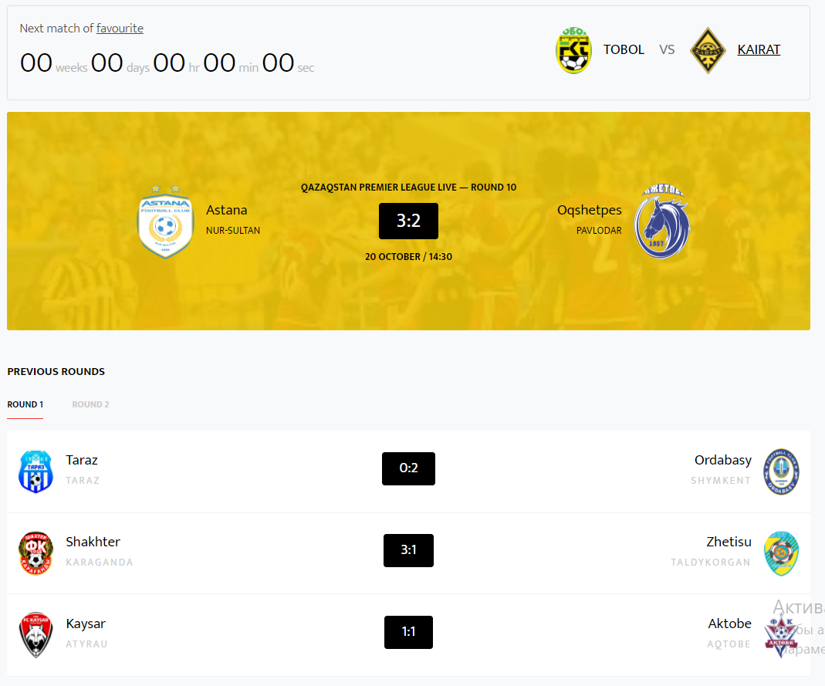
RELEVANCE
Have several pages for easy viewing
Have table with played
matches/ previous rounds

Slide 6
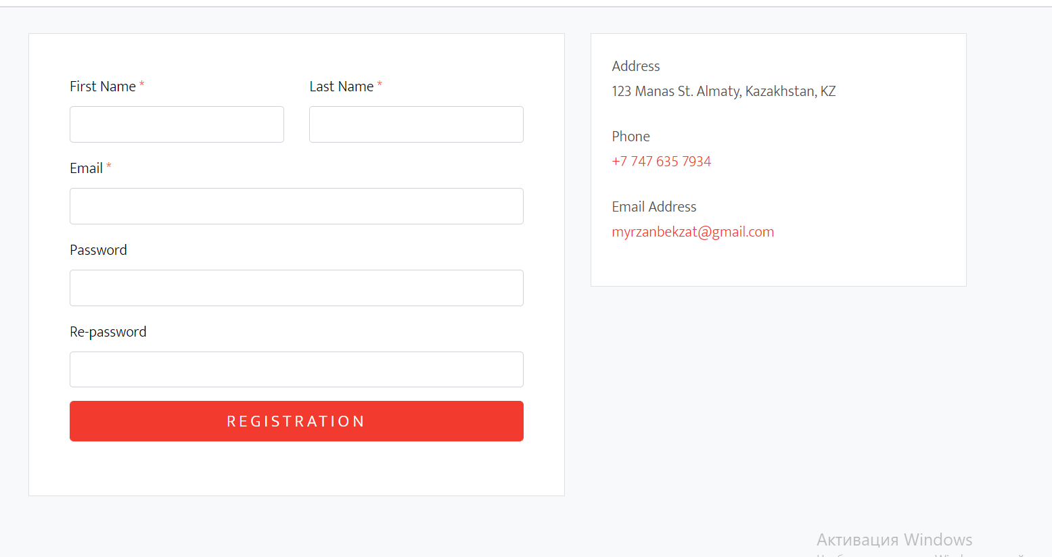
RELEVANCE
Block with form to registration

Slide 7
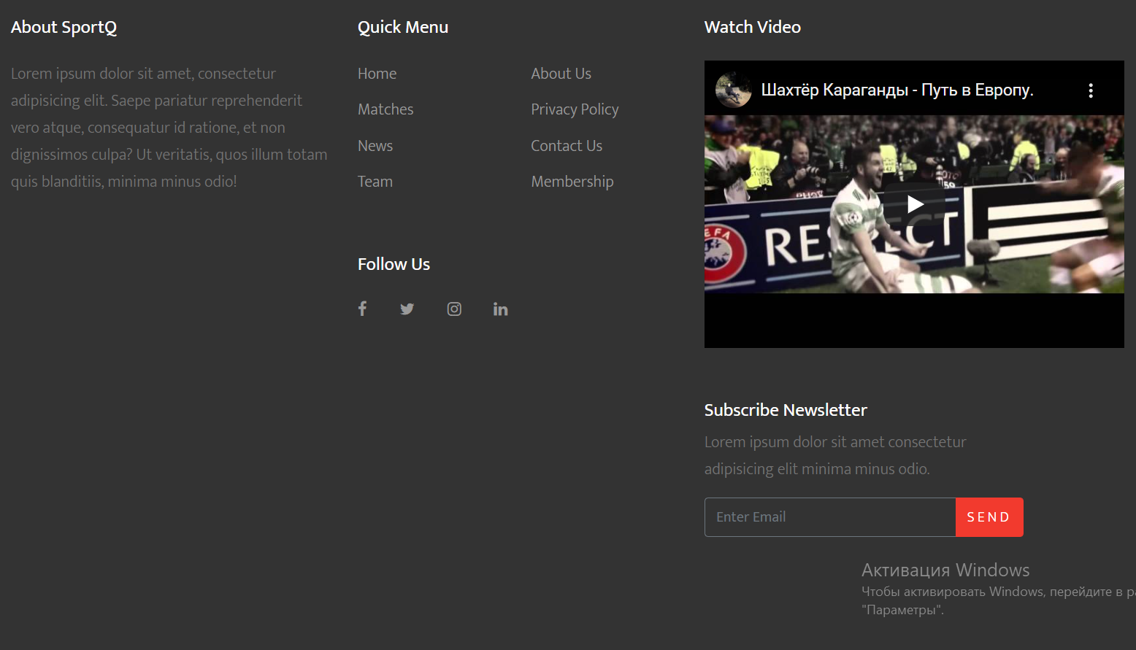
FEATURE
Have footer with links/blog/social links

Slide 8
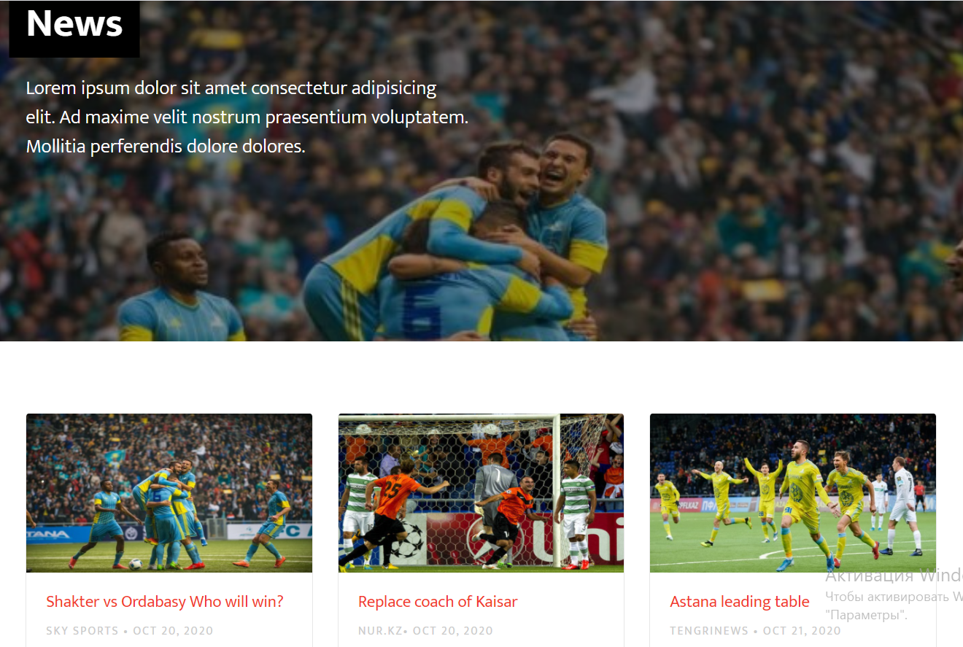
FEATURE
Have page with news in QPL

Slide 9
CONCLUSION
In conclusion, we create/build one fully working site/project with html5, css, js, bootstrap elements and practiced our skills gained during this 6 weeks
PHP can actually do anything related to server-side scripting or more popularly known as the backend of a website. For example, PHP can receive data from forms, generate dynamic page content, can work with databases, create sessions, send and receive cookies, send emails etc. There are also many hash functions available in PHP to encrypt user’s data that makes PHP secure and reliable to be used as a server-side scripting language. So these are some of the abilities of PHP that makes it suitable to be used as server-side scripting language.

Slide 10
REFERENCES
1. https://www.tutorialspoint.com/php/php_introduction.htm
2. https://www.w3schools.com/php/DEFAULT.asp
3. https://www.tutorialrepublic.com/php-tutorial/
4. https://www.php.net/manual/ru/tutorial.php
5. https://www.phptpoint.com/php-tutorial/
6. https://getbootstrap.com/docs/4.0/getting-started/introduction/
7.

